Slide 1

The GitHub map
A
Z
Ali Karooni & Lucas Bergeron
Notes:
The GitHub map from A to Z

Slide 2
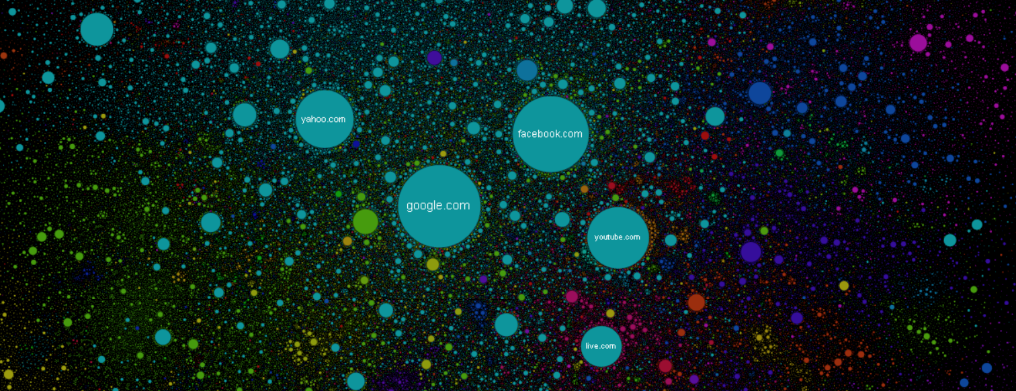
The internet map
Notes:
Inspired from the internet map : https://internet-map.net/
There is no X or Y axis but an algorithme using attraction and repulsion.

Slide 3
Our objectives
4
0.5
f
2
Page ranking
Plotting
A
d
0.1
0.5
h
1
c
D
C
a
1.5
1.5
b
g
1
1
e
1
UPPERCASE = Repositories
lowercase = Users
Number = Weight (proceed with pagerank)
1
B
K
0.5

Slide 4
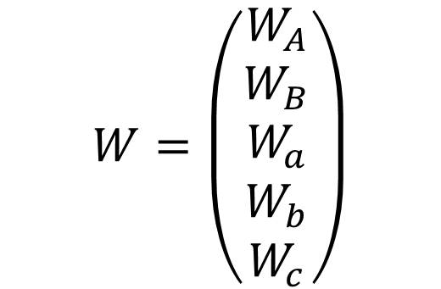
Page Ranking algorithm
a
A
6
$$W=\left(\begin{aligned}W_{A} \\ W_{B} \\ W_{a} \\ W_{b} \\ W_{c}\end{aligned}\right)$$
2
b
1
c
3
4
B

Slide 5
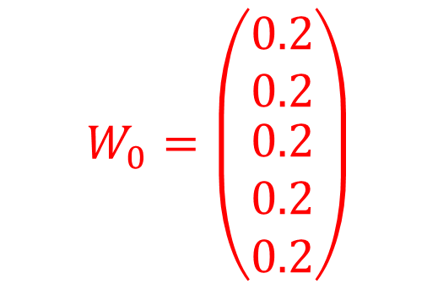
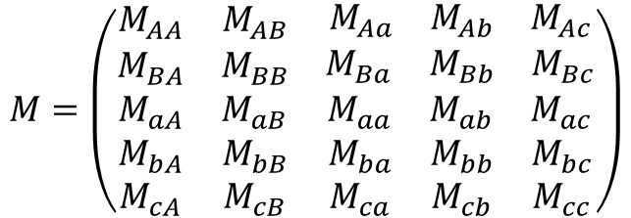
Page Ranking algorithm
a
0.2
A
0.2
< 67%
$$M=\left(\begin{matrix}M_{AA} & M_{AB} & \begin{matrix}M_{Aa} & M_{Ab} & M_{Ac}\end{matrix} \\ M_{BA} & M_{BB} & \begin{matrix}M_{Ba} & M_{Bb} & M_{Bc}\end{matrix} \\ \begin{aligned}M_{aA} \\ M_{bA} \\ M_{cA}\end{aligned} & \begin{aligned}M_{aB} \\ M_{bB} \\ M_{cB}\end{aligned} & \begin{matrix}\begin{aligned}M_{aa} \\ M_{ba} \\ M_{ca}\end{aligned} & \begin{aligned}M_{ab} \\ M_{bb} \\ M_{cb}\end{aligned} & \begin{aligned}M_{ac} \\ M_{bc} \\ M_{cc}\end{aligned}\end{matrix}\end{matrix}\right)$$
100% >
< 11%
< 33%
25% >
22% >
b
0.2
c
0.2
$$W_{0}=\left(\begin{matrix}0.2 \\ 0.2 \\ \begin{matrix}0.2 \\ 0.2 \\ 0.2\end{matrix}\end{matrix}\right)$$
< 43%
< 67%
57% >
75% >
B
0.2

Slide 6
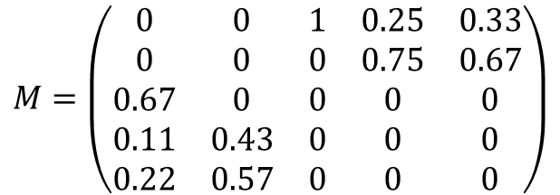
Page Ranking algorithm
a
0.2
A
0.2
< 67%
$$M=\left(\begin{matrix}0 & 0 & 1 & 0.25 & 0.33 \\ 0 & 0 & 0 & 0.75 & 0.67 \\ 0.67 & 0 & 0 & 0 & 0 \\ 0.11 & 0.43 & 0 & 0 & 0 \\ 0.22 & 0.57 & 0 & 0 & 0\end{matrix}\right)$$
100% >
< 11%
< 33%
25% >
22% >
b
0.2
c
0.2
$$W_{0}=\left(\begin{matrix}0.2 \\ 0.2 \\ \begin{matrix}0.2 \\ 0.2 \\ 0.2\end{matrix}\end{matrix}\right)$$
< 43%
< 67%
57% >
75% >
B
0.2

Slide 7
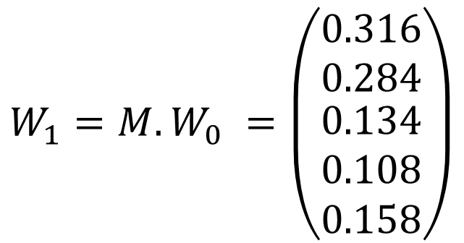
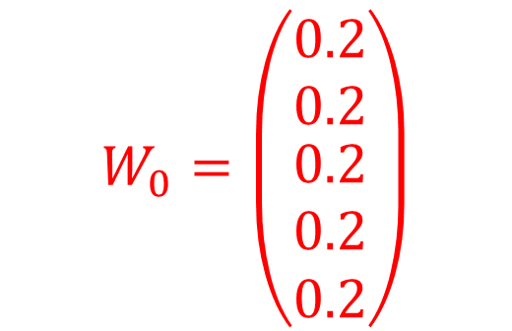
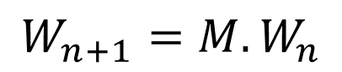
Page ranking algorithm
$$W_{n+1}=M.W_{n}$$
a
0.2
A
0.2
< 67%
$$W_{0}=\left(\begin{matrix}0.2 \\ 0.2 \\ \begin{matrix}0.2 \\ 0.2 \\ 0.2\end{matrix}\end{matrix}\right)$$
100% >
< 11%
< 33%
0.134
25% >
0.316
22% >
b
0.2
c
0.2
$$W_{1}=M.W_{0} =\left(\begin{matrix}0.316 \\ 0.284 \\ \begin{matrix}0.134 \\ 0.108 \\ 0.158\end{matrix}\end{matrix}\right)$$
< 43%
< 67%
0.108
57% >
0.158
75% >
B
0.2
0.284
Notes:
https://towardsdatascience.com/graphs-and-paths-pagerank-54f180a1aa0a

Slide 8
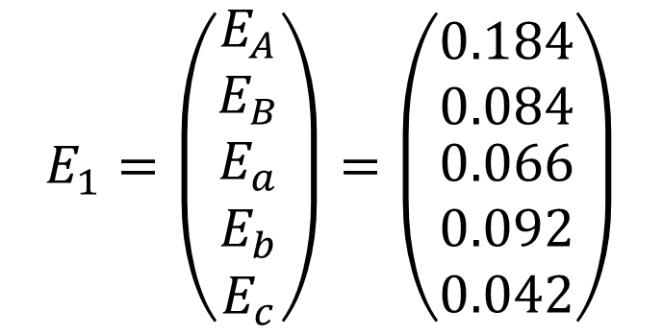
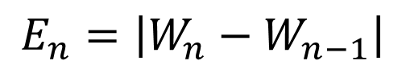
Page Ranking algorithm
$$E_{n}=\left|W_{n}−W_{n−1}\right|$$
a
0.2
A
0.2
< 67%
$$E_{1}=\left(\begin{matrix}E_{A} \\ E_{B} \\ \begin{matrix}E_{a} \\ E_{b} \\ E_{c}\end{matrix}\end{matrix}\right)=\left(\begin{matrix}0.184 \\ 0.084 \\ \begin{matrix}0.066 \\ 0.092 \\ 0.042\end{matrix}\end{matrix}\right)$$
100% >
< 11%
< 33%
0.134
25% >
0.316
22% >
b
0.2
c
0.2
< 43%
< 67%
0.108
57% >
0.158
75% >
B
0.2
Threshold = 0.1
0.284
Notes:
https://towardsdatascience.com/graphs-and-paths-pagerank-54f180a1aa0a

Slide 9
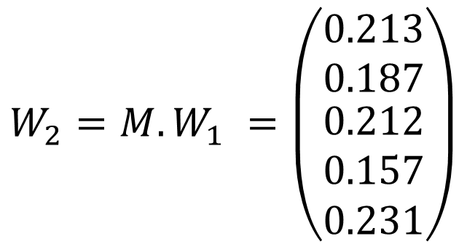
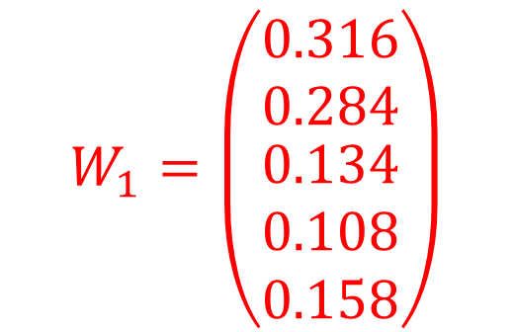
Page Ranking algorithm
$$W_{n+1}=M.W_{n}$$
a
0.2
A
0.2
< 67%
$$W_{1}=\left(\begin{matrix}0.316 \\ 0.284 \\ \begin{matrix}0.134 \\ 0.108 \\ 0.158\end{matrix}\end{matrix}\right)$$
100% >
< 11%
< 33%
0.134
0.212
25% >
0.316
0.213
22% >
b
0.2
c
0.2
$$W_{2}=M.W_{1} =\left(\begin{matrix}0.213 \\ 0.187 \\ \begin{matrix}0.212 \\ 0.157 \\ 0.231\end{matrix}\end{matrix}\right)$$
< 43%
< 67%
0.108
0.157
57% >
0.158
0.231
75% >
B
0.2
0.284
0.187
Notes:
https://towardsdatascience.com/graphs-and-paths-pagerank-54f180a1aa0a

Slide 10
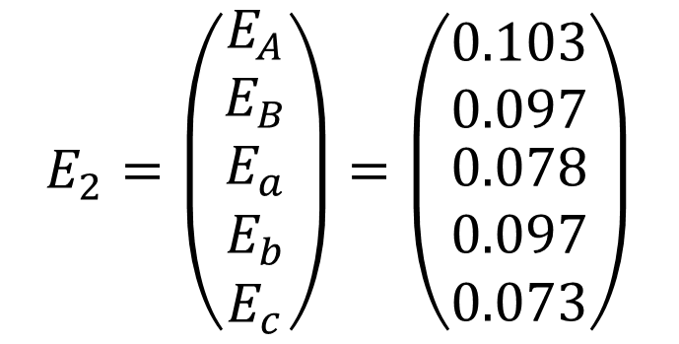
Page Ranking algorithm
$$E_{n}=\left|W_{n}−W_{n−1}\right|$$
a
0.2
A
0.2
< 67%
$$E_{2}=\left(\begin{matrix}E_{A} \\ E_{B} \\ \begin{matrix}E_{a} \\ E_{b} \\ E_{c}\end{matrix}\end{matrix}\right)=\left(\begin{matrix}0.103 \\ 0.097 \\ \begin{matrix}0.078 \\ 0.097 \\ 0.073\end{matrix}\end{matrix}\right)$$
100% >
< 11%
< 33%
0.134
0.212
25% >
0.316
0.213
22% >
b
0.2
c
0.2
< 43%
< 67%
0.108
0.157
57% >
0.158
0.231
75% >
B
0.2
Threshold = 0.1
0.284
0.187
Notes:
https://towardsdatascience.com/graphs-and-paths-pagerank-54f180a1aa0a

Slide 11
Page Ranking with mappers & reducers
Input (links)
Output (weights)
Repo | Email | Commits
A | a@a.com | 6
A | c@c.com | 2
B | b@b.com | 3
A | b@b.com | 1
B | c@c.com | 4
User/Repo | Weight
A | 0.316
B | 0.284
c | 0.158
a | 0.134
b | 0.108
Page Ranking
Process
Notes:
https://towardsdatascience.com/graphs-and-paths-pagerank-54f180a1aa0a

Slide 12
Page Ranking – Step 1
S
Key
Value
Mapper
Key
Values
Reducer
S
Notes:
https://towardsdatascience.com/graphs-and-paths-pagerank-54f180a1aa0a

Slide 13
Thank you !
A
Z
Ali Karooni & Lucas Bergeron
Notes:
Thanks a lot for your attention. from A to Z ;)

